Slide 1
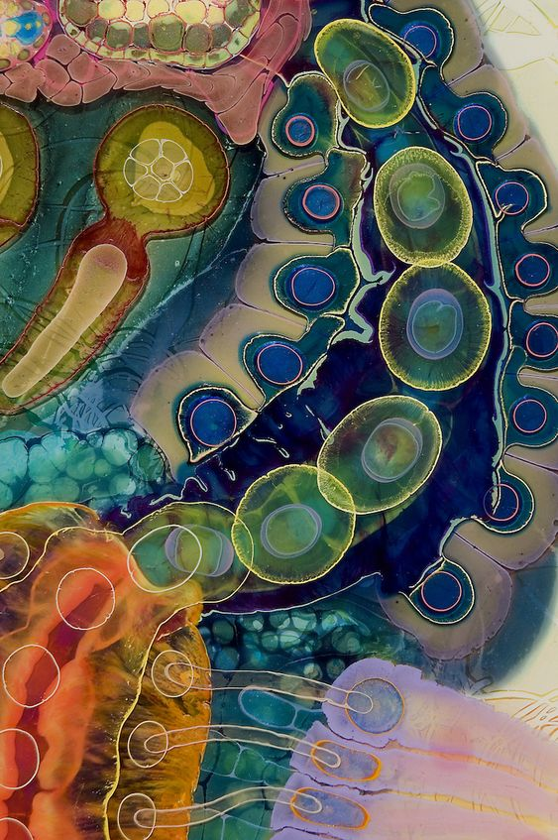
Multi-Omics Enrichment Analysis Protocol
Multi-Omics Enrichment Analysis Protocol
Ghadi El Hasbani
Frederick Abi Chahine
Bilal Hamdanieh
Lebanese American University
CSC 613 – Eileen-Marie Hanna, PhD
Ghadi El Hasbani
Frederick Abi Chahine
Bilal Hamdanieh
Lebanese American University
CSC 613 – Eileen-Marie Hanna, PhD

Slide 2
Table of Contents
Table of Contents
Background ……………. 3
LEAN ……………………… 5
PathFindR ………………. 7
GeneSurrounder ……… 10
DMFIND …………………. 13
mND ……………………… 15
Protocol ………………… 18
Analysis ….……………... 22
References …………….. 36
2
2

Slide 3
BACKGROUND
ToC
BACKGROUND
3
3

Slide 4
BACKGROUND
ToC
- Differential Expression Analysis (DEA) does not consider interactions → missed multi-gene interactions → poor consensus
- Recent methods use networks to consider gene-gene connections
- Interactive and network nature of biological systems encouraged interest in identifying functional gene modules
4

Slide 5
LEAN
ToC
LEAN
5
5

Slide 6
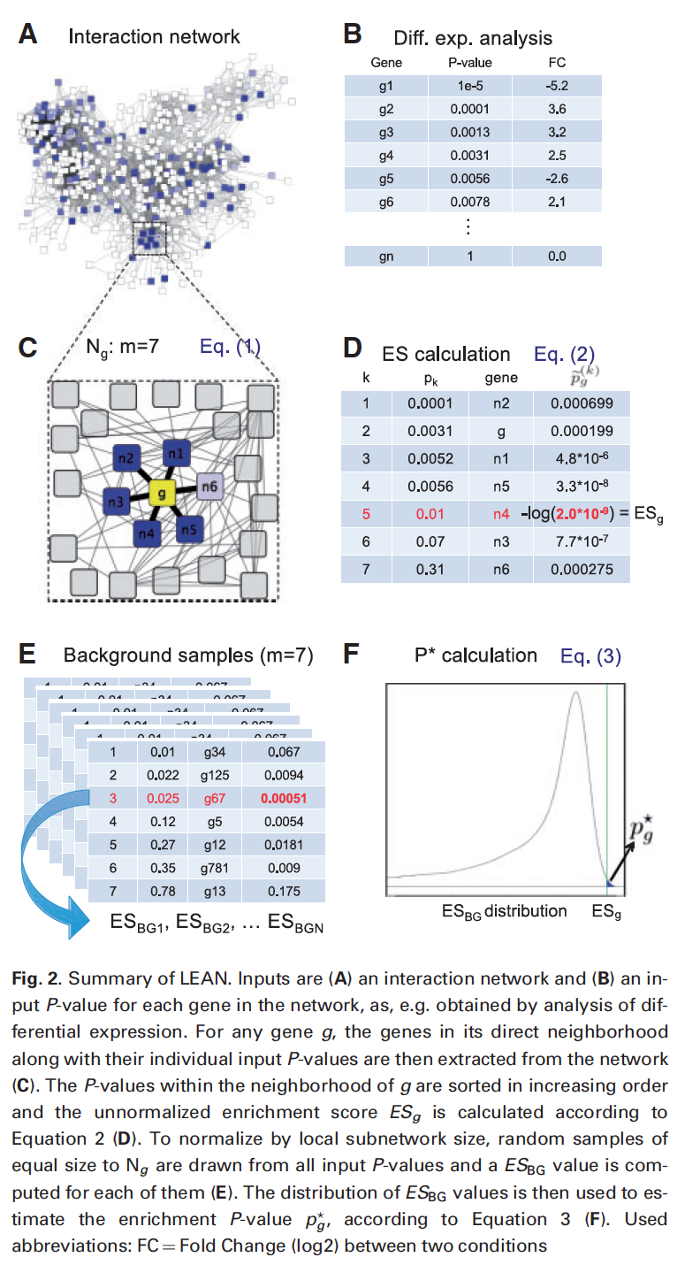
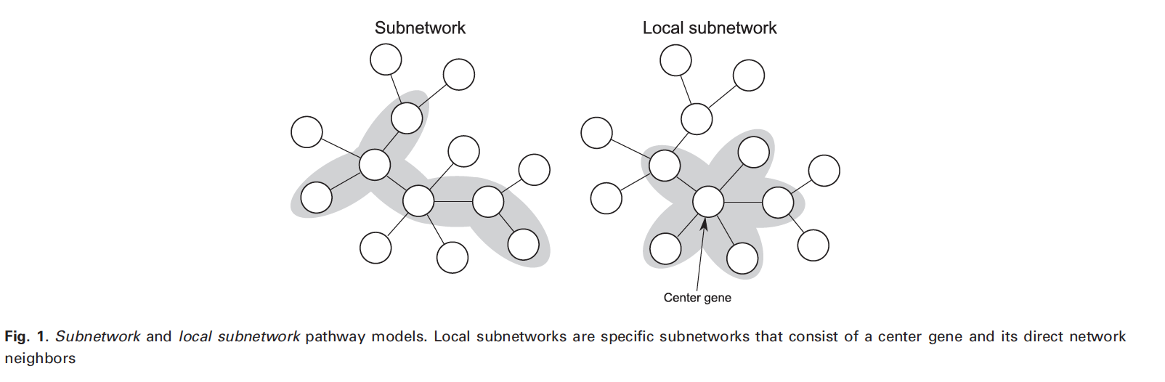
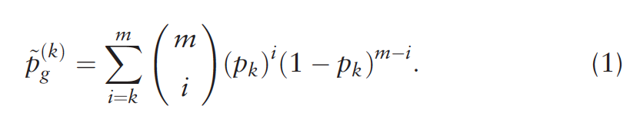
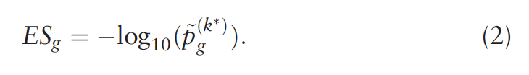
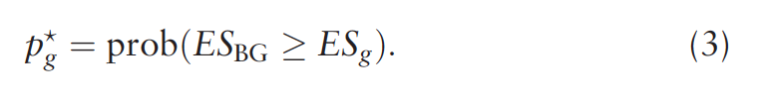
ToC
Advantage:
Interpretability, less statistical bias
Disadvantage:
Does not consider neighbors at R >= 1, singe-omics
6

Slide 7
PathFindR
ToC
PathFindR
7
7

Slide 8
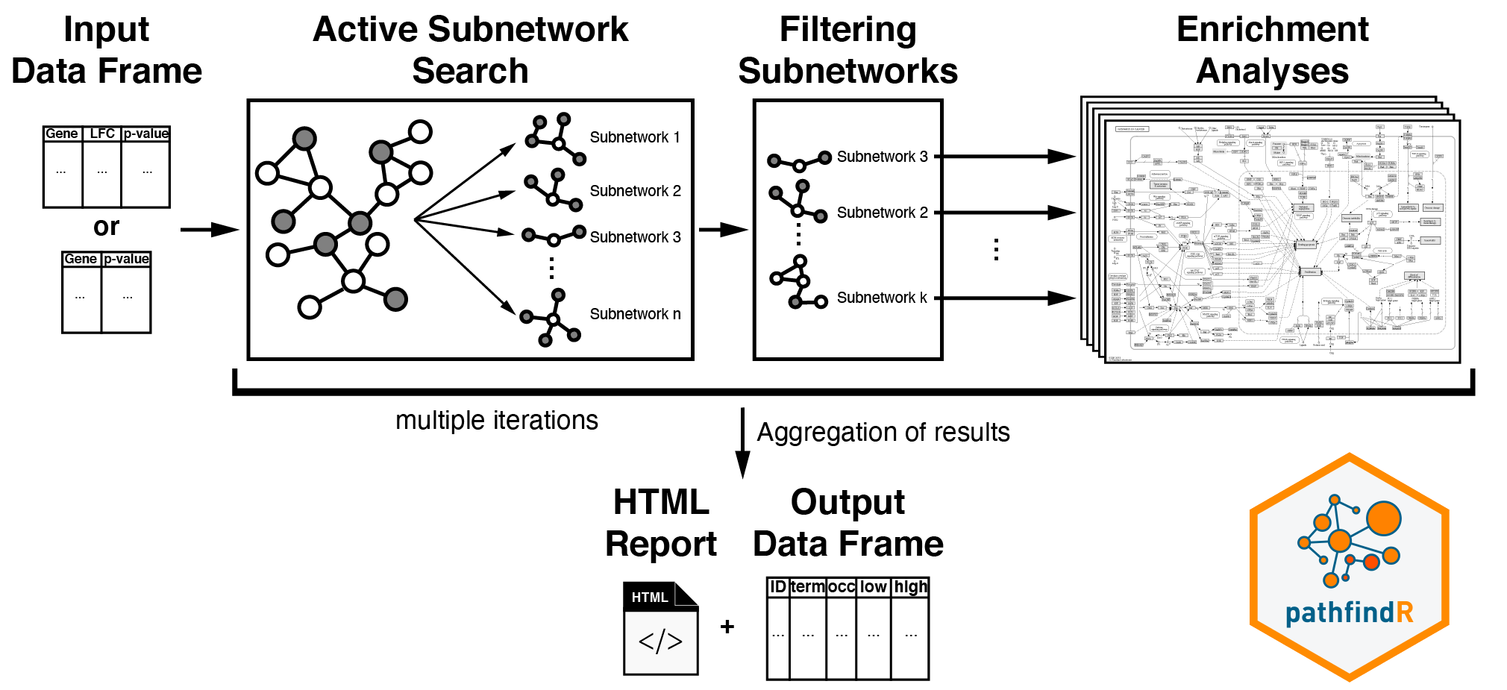
ToC
Currently, there are three algorithms implemented in pathfindR for active subnetwork search: Greedy Algorithm (default, based on Ideker et al. ²), Simulated Annealing Algorithm (based on Ideker et al. ³) and Genetic Algorithm (based on Ozisik et al. ⁴).
The resulting active subnetworks are then filtered based on their scores and the number of significant genes they contain
Filtering Enriched Terms by Adjusted-p Values
Disadvantage:
Informativeness, statistical bias
Gene Sets for Enrichment
Note: The active-subnetwork-oriented enrichment analyses can be performed on any gene sets (biological pathways, gene ontology terms, transcription factor target genes, miRNA target genes etc.). The available gene sets in pathfindR are “KEGG”, “Reactome”, “BioCarta”, “GO-All”, “GO-BP”, “GO-CC” and “GO-MF”
8

Slide 9
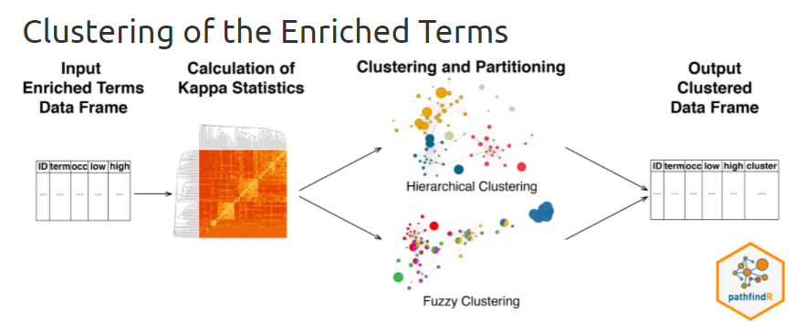
ToC
Advantage:
Considers R >= 1
Disadvantage:
Does not consider Decay, user-defined R, single-omics
9

Slide 10
GeneSurrounder
ToC
GeneSurrounder
10
10

Slide 11
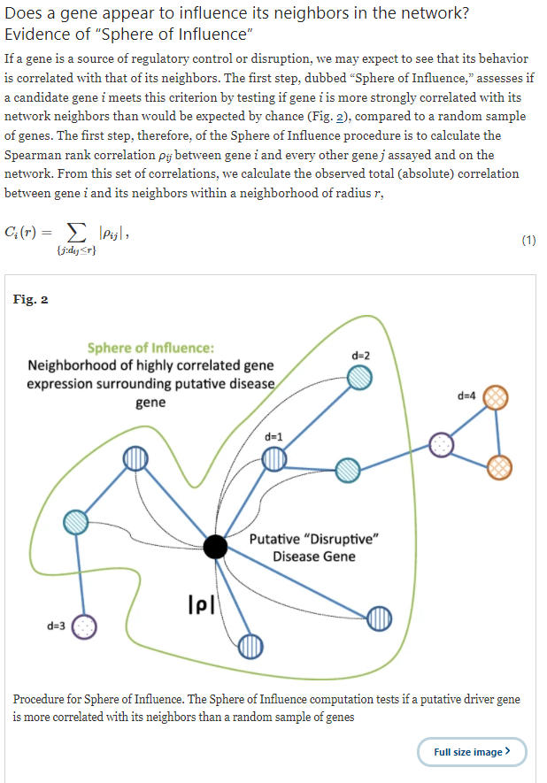
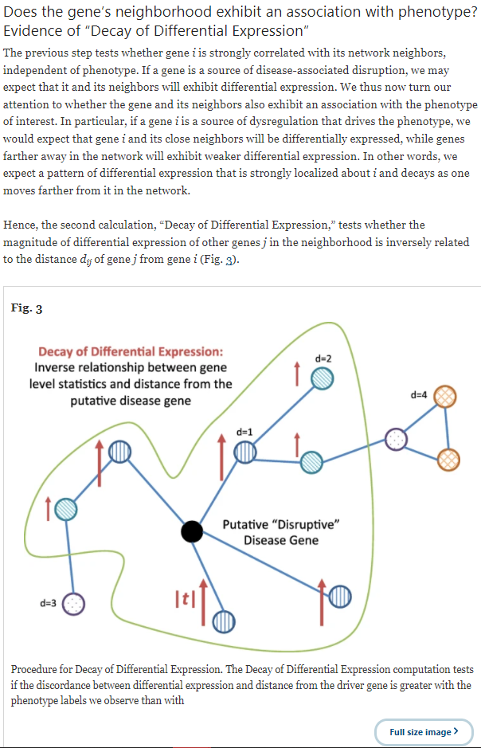
ToC
11

Slide 12
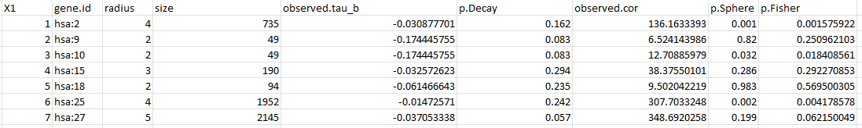
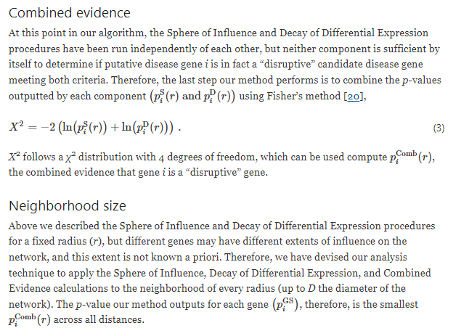
ToC
Advantage:
Automatic determination of R based on biologically-relevant process
Disadvantage:
time-complexity, single-omics
12

Slide 13
DMFIND
ToC
DMFIND
13
13

Slide 14
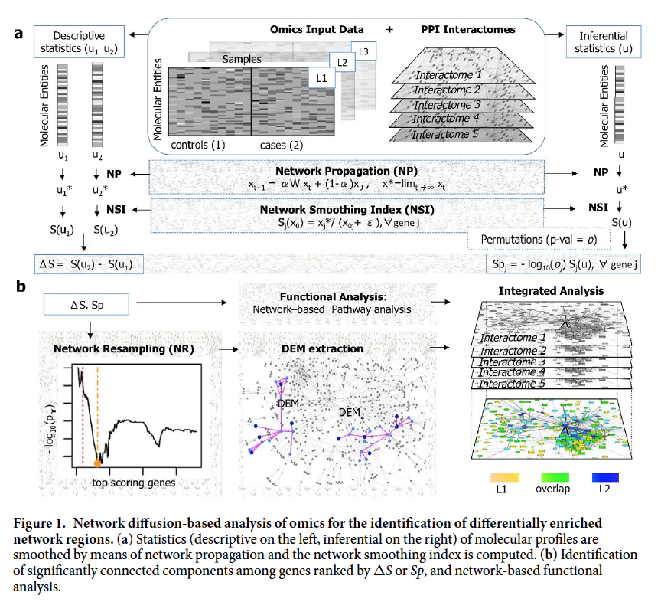
ToC
Advantage:
Considers neighbors at R >= 1, multi-omics
Disadvantage:
Does not consider Decay
14

Slide 15
mND
ToC
mND
15
15

Slide 16
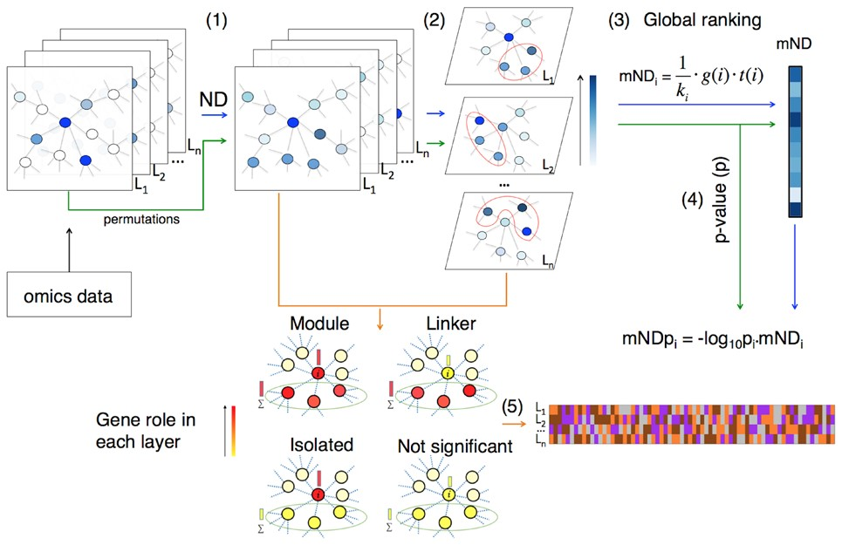

Fig. 1. Flowchart of the analysis pipeline with mND. (1) Network-diffusion is applied to the original dataset, ...
ToC
16
Notes:
Fig. 1. Flowchart of the analysis pipeline with mND. (1) Network-diffusion is applied to the original dataset, composed of multiple layers L1, L2, …, Ln (e.g. different types of omics or multiple samples of same omic type); (2) identification of the top k neighbours for each gene in each layer; (3) calculation of mND score; (4) empirical P-value assessment; (5) classification of genes across layers
Unless provided in the caption above, the following copyright applies to the content of this slide: © The Author(s) 2019. Published by Oxford University Press.This is an Open Access article distributed under the terms of the Creative Commons Attribution License (http://creativecommons.org/licenses/by/4.0/), which permits unrestricted reuse, distribution, and reproduction in any medium, provided the original work is properly cited.

Slide 17
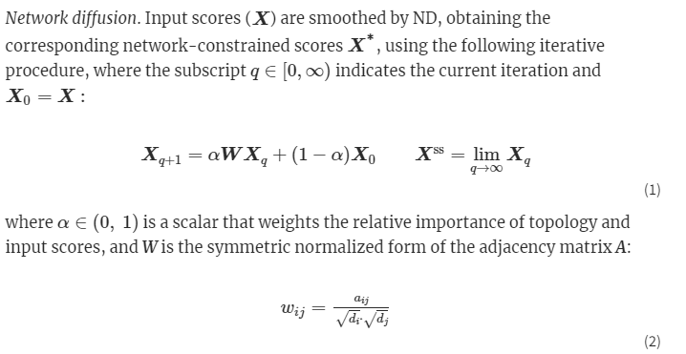
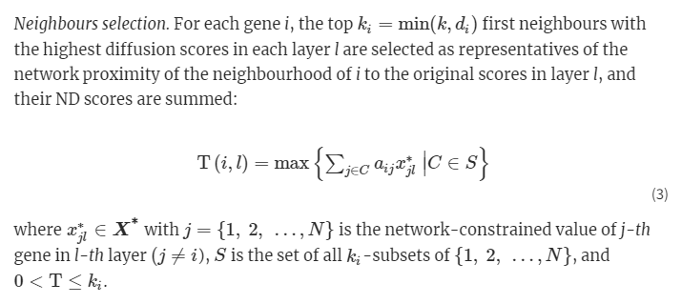
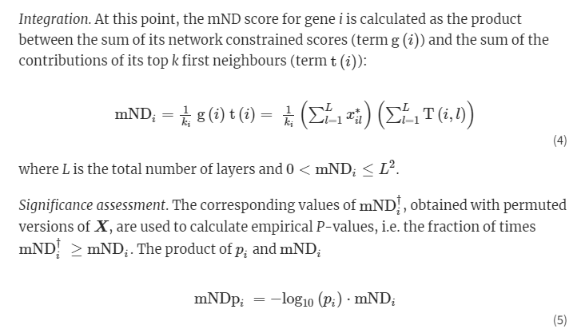
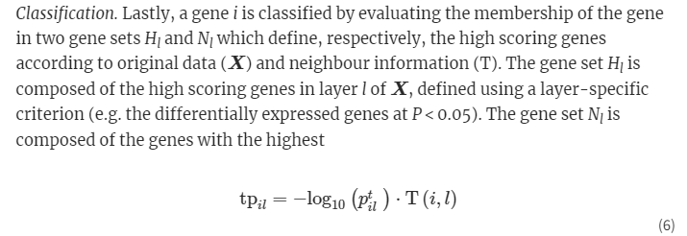
ToC
Advantage:
Multi-omics, informativeness
Disadvantage:
Does not consider Decay and neighbors R >= 1
17
Notes:
Fig. 1. Flowchart of the analysis pipeline with mND. (1) Network-diffusion is applied to the original dataset, composed of multiple layers L1, L2, …, Ln (e.g. different types of omics or multiple samples of same omic type); (2) identification of the top k neighbours for each gene in each layer; (3) calculation of mND score; (4) empirical P-value assessment; (5) classification of genes across layers
Unless provided in the caption above, the following copyright applies to the content of this slide: © The Author(s) 2019. Published by Oxford University Press.This is an Open Access article distributed under the terms of the Creative Commons Attribution License (http://creativecommons.org/licenses/by/4.0/), which permits unrestricted reuse, distribution, and reproduction in any medium, provided the original work is properly cited.

Slide 18
Protocol
ToC
Protocol
18
18

Slide 19
Why?
ToC
None of the previous methods combine:
1- Informativeness and robustness of modules of R = 1
2- multi-omics analysis
3- Decay of gene expression effect to consider neighbors at R >= 1
We propose a protocol that combines all three advantages using GS and mND
19

Slide 20
Data & Packages
ToC
Breast Cancer (BC) data from the mND R package, originally from TCGA
11796 genes
Layer 1: Somatic Mutation Frequency
Layer 2: DE score
hg38 reference genome
STRING interactome also from mND R package
GeneSurrounder R functions were downloaded from GitHub and a parallelized implementation was developed for time-complexity
List of BC-related genes from eDGAR, DrugBank, and MalaCards from AutoSeed R package
KEGG pathways from KEGGREST R package
20

Slide 21
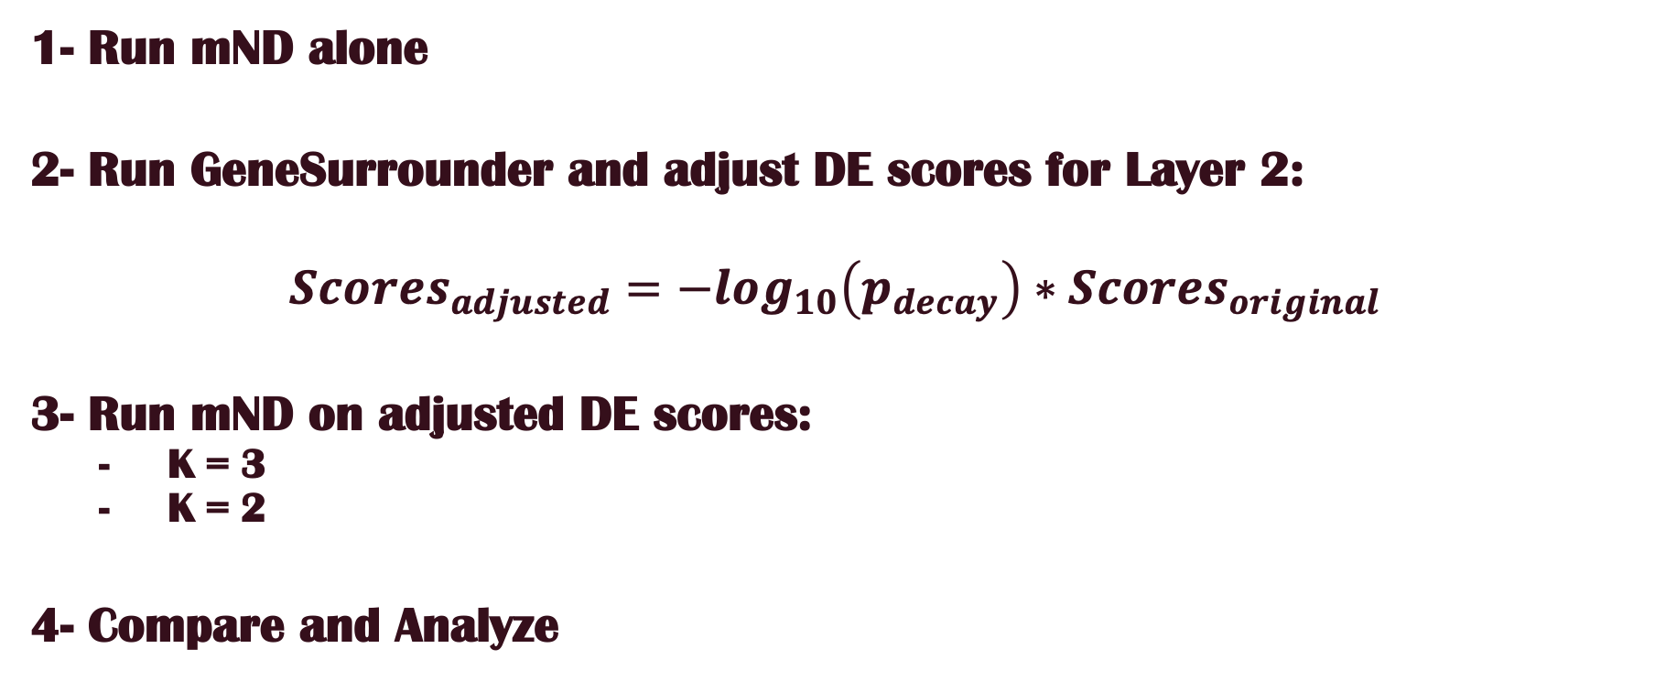
Protocol
ToC
1- Run mND alone
2- Run GeneSurrounder and adjust DE scores for Layer 2:
$$Scores_{adjusted}=−log_{10}\left(p_{decay}\right)∗Scores_{original}$$
3- Run mND on adjusted DE scores:
K = 3
K = 2
4- Compare and Analyze
21

Slide 22
Analysis
ToC
Analysis
22
22

Slide 23
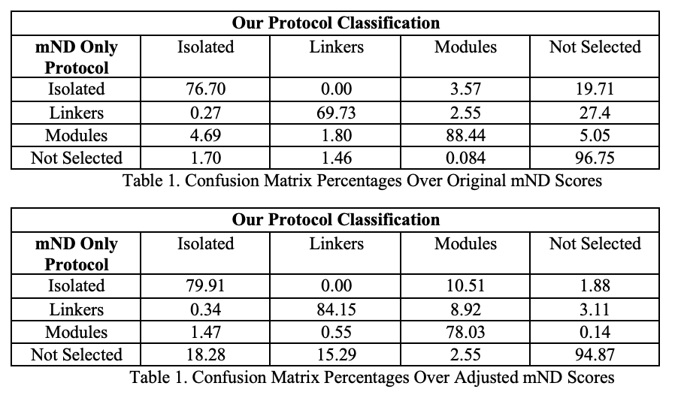
Classification
ToC
7.7% additionally significant with mNDp =< 0.05
8.5 % of significant genes not detected by mND alone
69 new (distinct) modules
32 discarded modules
245 common modules
201 less selected genes
23

Slide 24
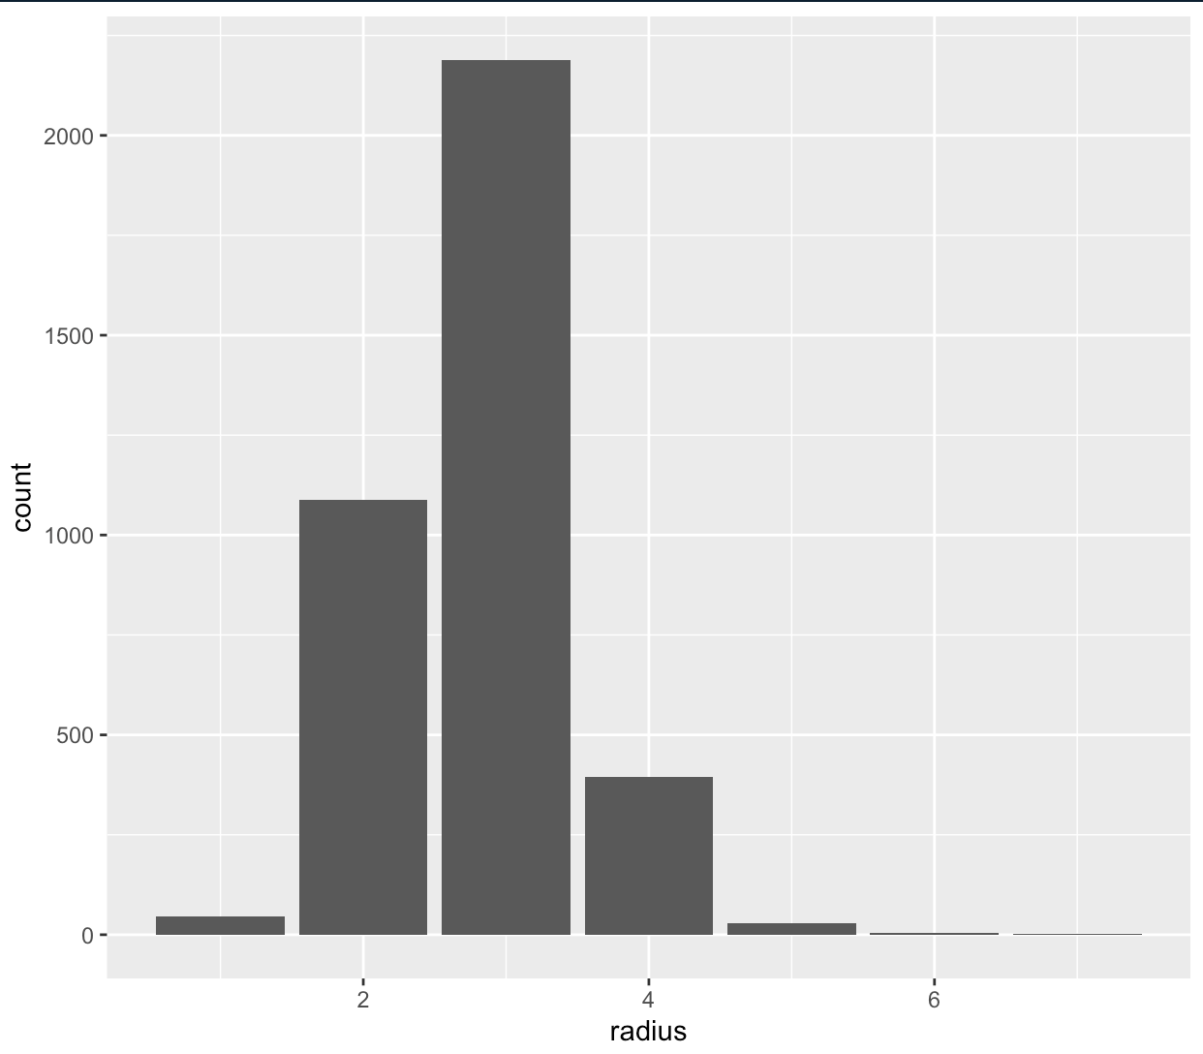
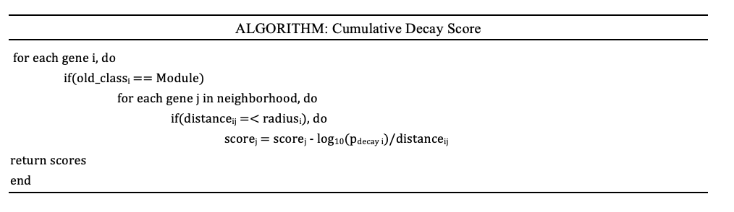
Cumulative Decay Score
ToC
24

Slide 25
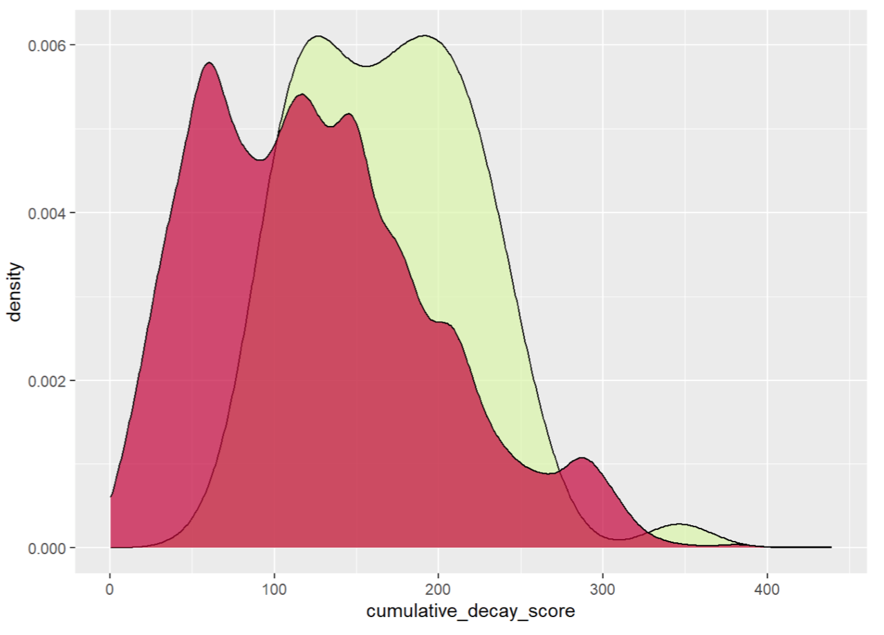
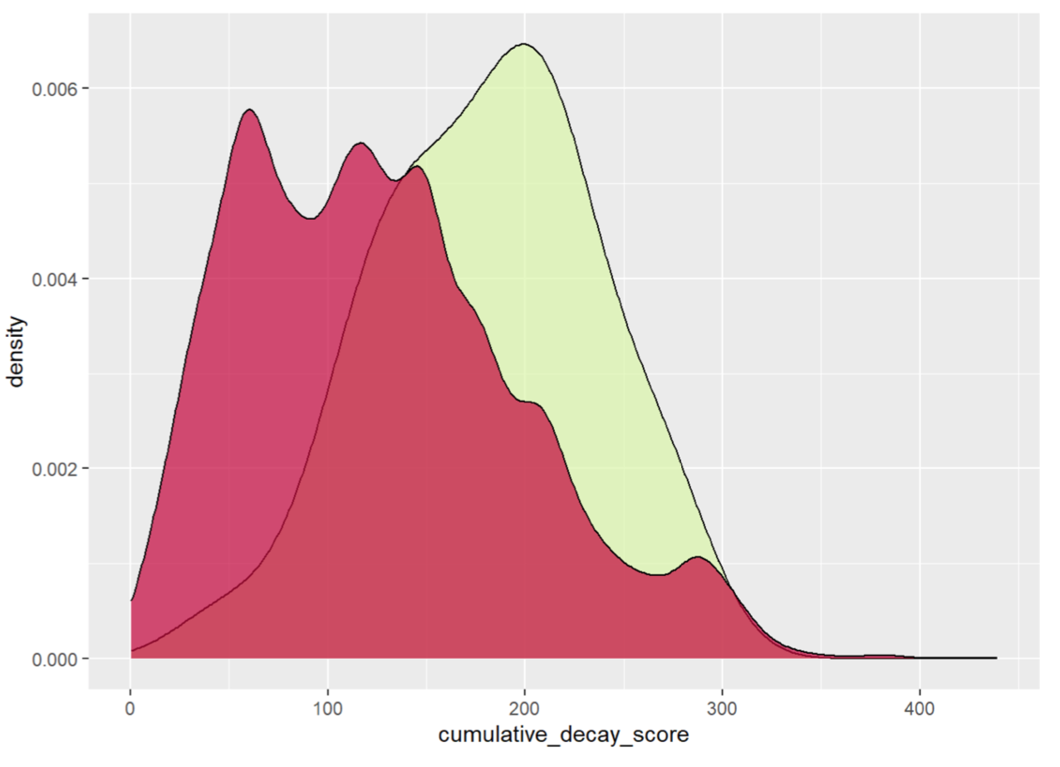
Cumulative Decay Score
ToC
Distinct M in green
Discarded M in green
F-test ratio: 0.55, p-value = 0.002,
[0.41, 0.80]
F-test ratio: 0.61, p-value = 0.083,
[0.39, 1.07]
t-test ratio: 1.38, p-value = 5.896e-09,
[29.82, 55.46]
t-test ratio: 1.43, p-value = 5.055e-06,
[33.95, 74.00]
25

Slide 26
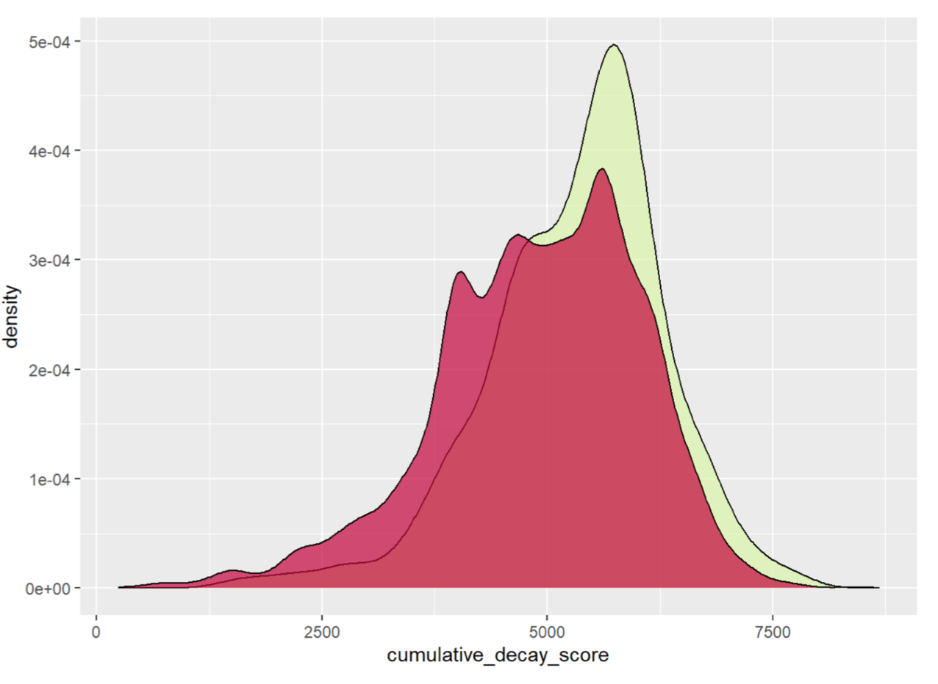
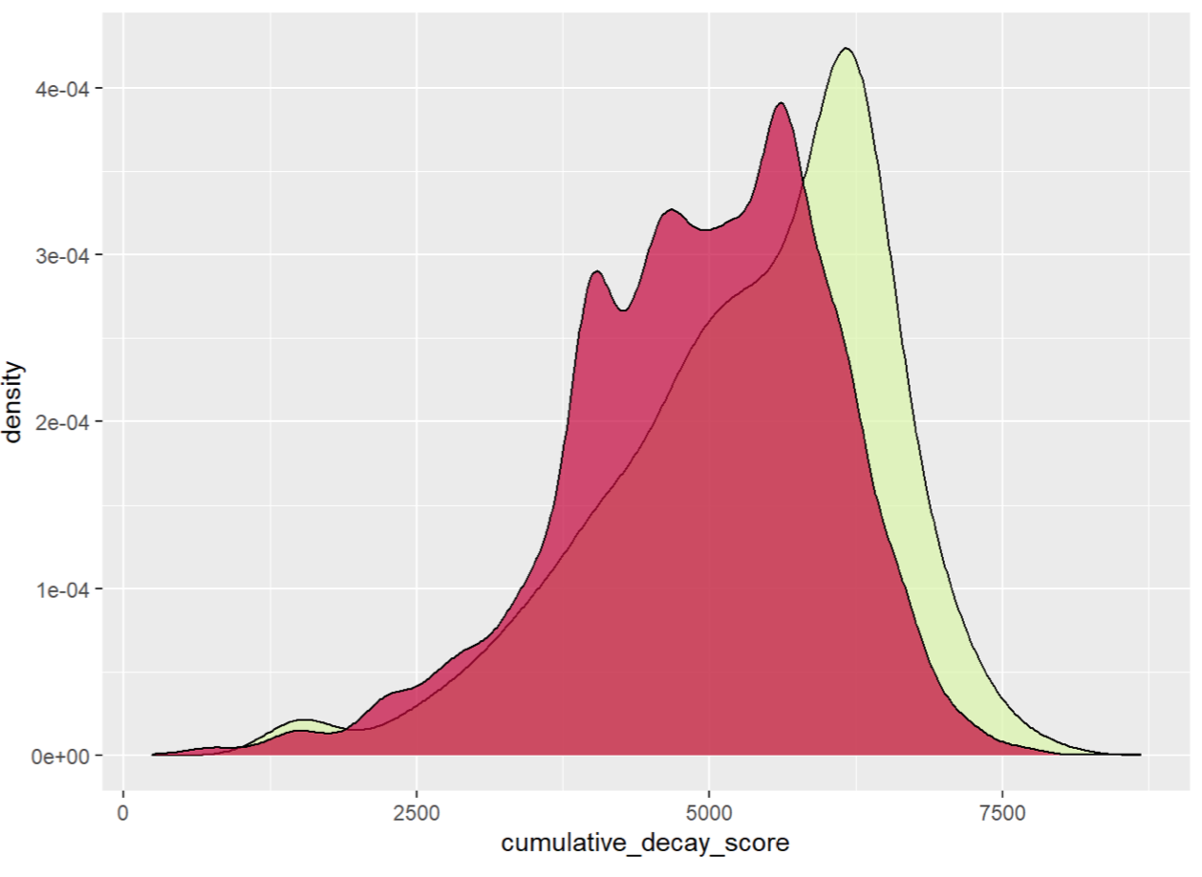
Cumulative Decay Score
ToC
Distinct I&L in green
Discarded I&L in green
F-test ratio: 0.75, p-value = 0.0005,
[0.64, 0.88]
F-test ratio: 1.13, p-value = 0.053,
[0.99, 1.31]
t-test ratio: 1.085, p-value = 5.429e-13,
[308.39, 527.51]
t-test ratio: 1.086, p-value = 3.032e-12,
[304.99, 535.35]
26

Slide 27
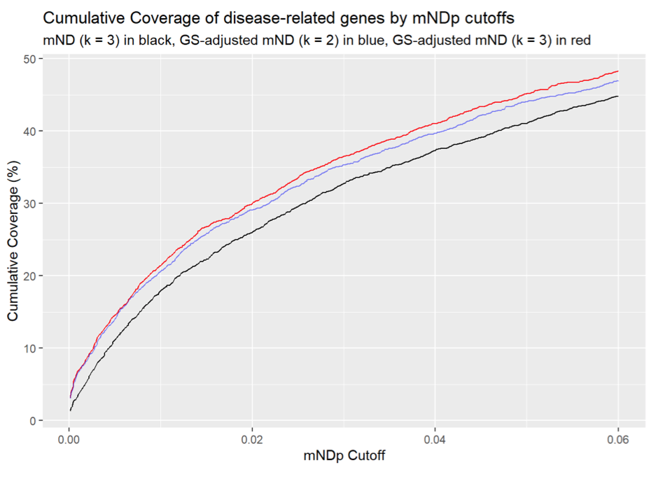
Coverage
ToC
516 matched from old M (21.75% of selected)
478 matched from new M (20.78% of selected)
(only intersection between BC gene list and full gene list considered)
27

Slide 28
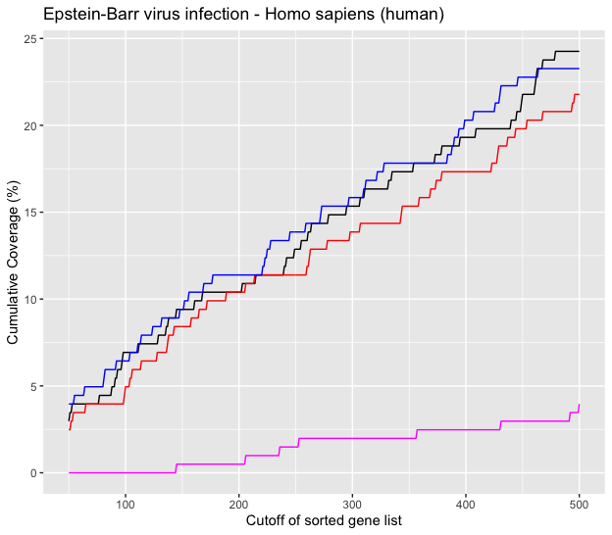
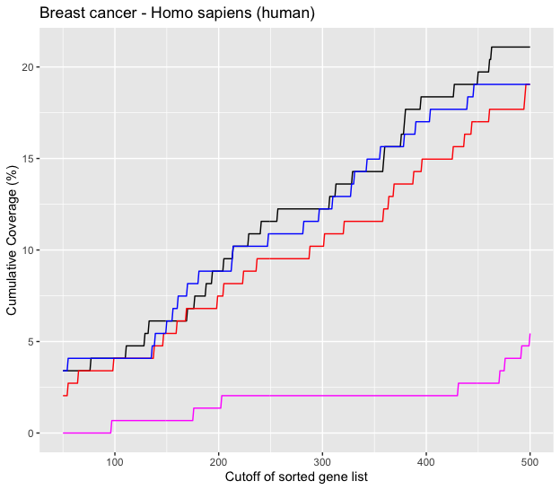
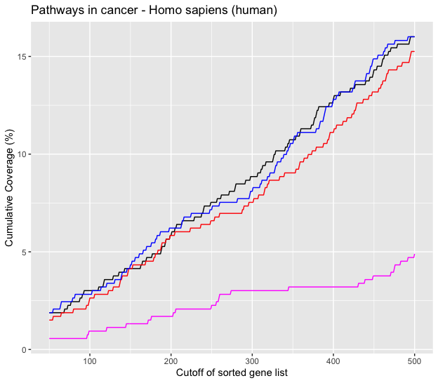
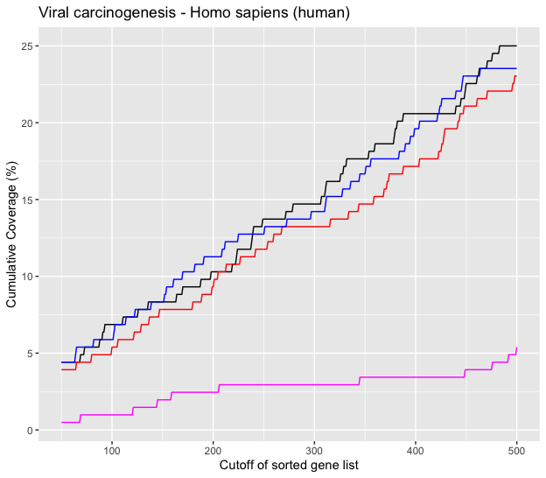
Enrichment
ToC
28

Slide 29
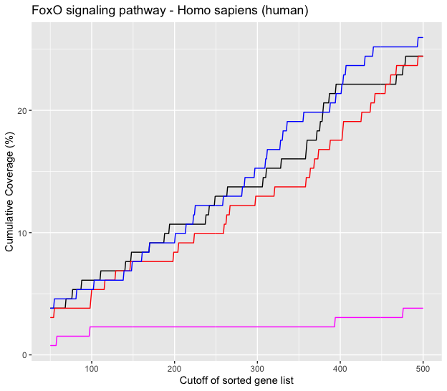
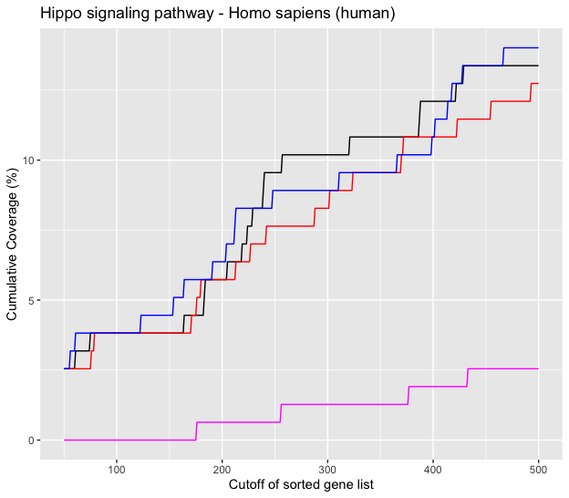
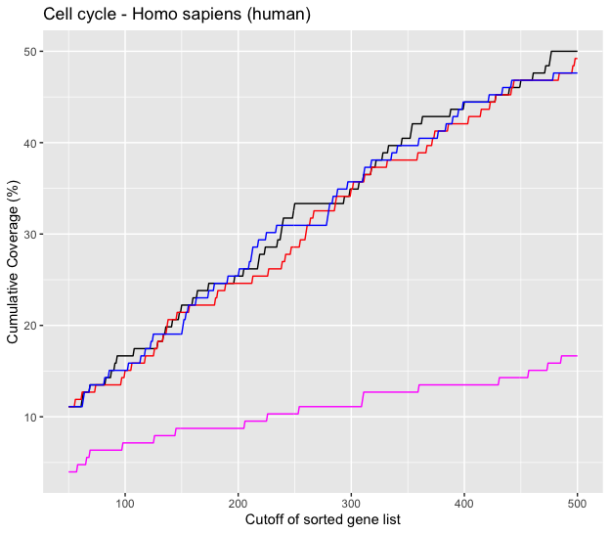
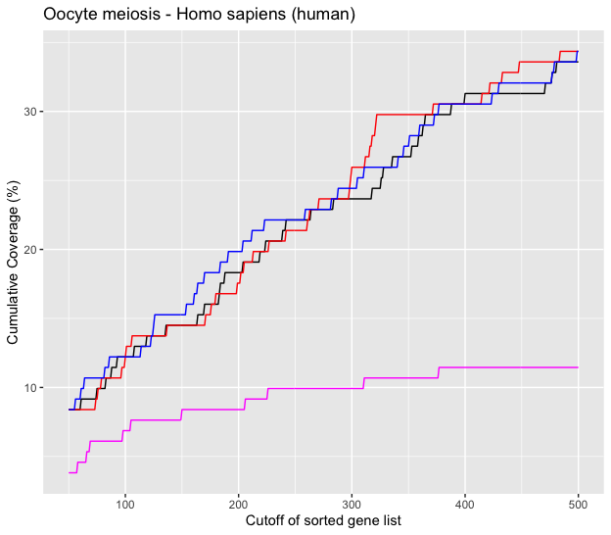
Enrichment
ToC
29

Slide 30
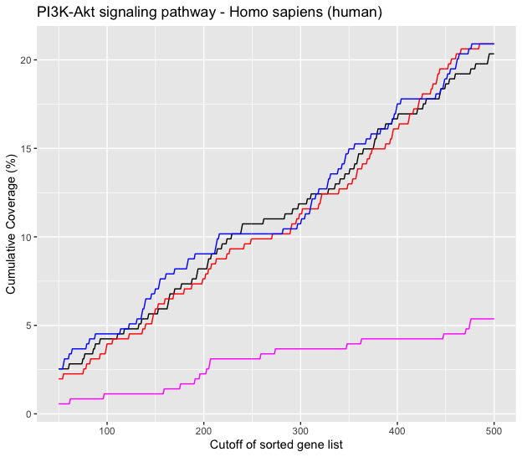
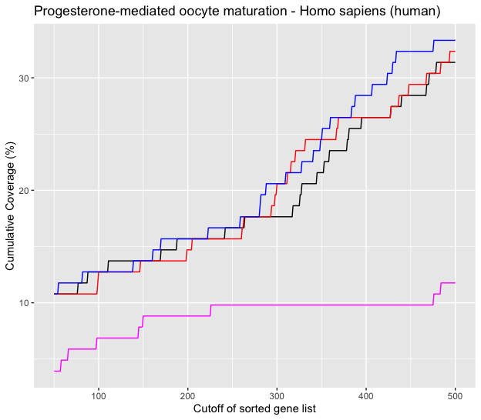
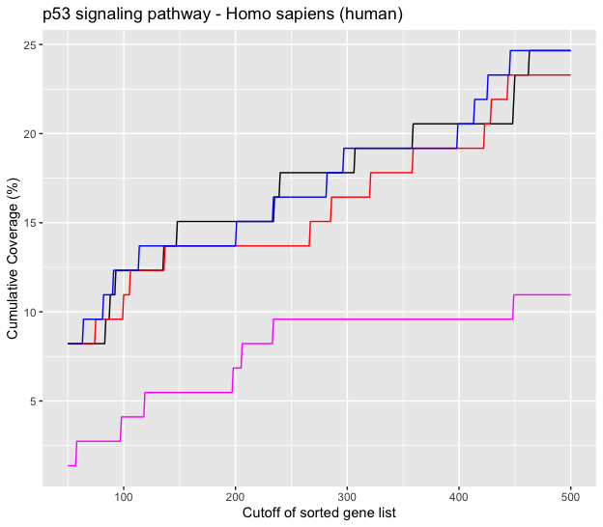
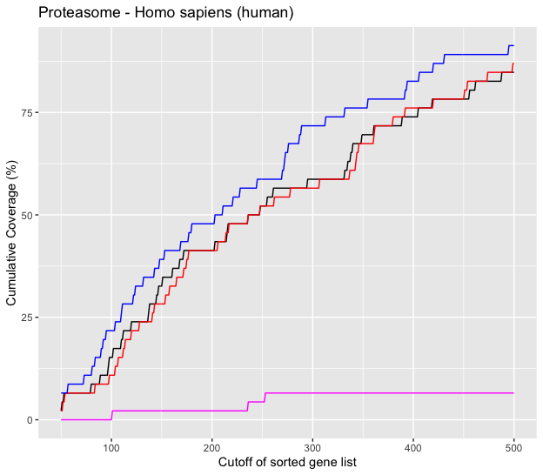
Enrichment
ToC
30

Slide 31
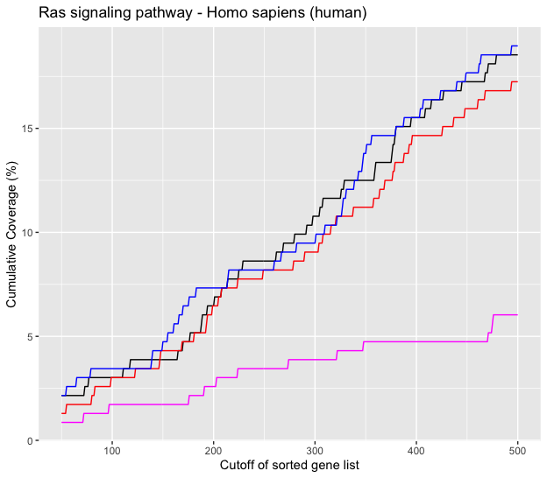
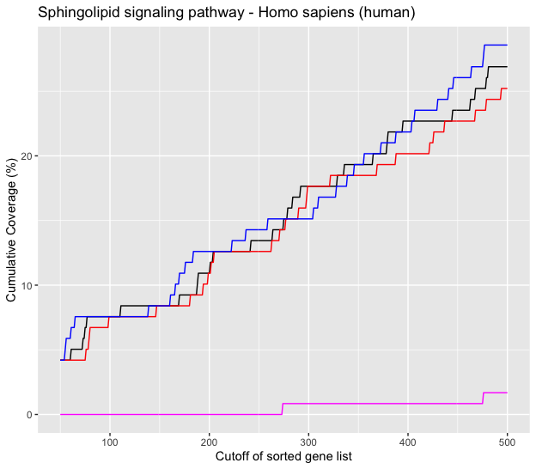
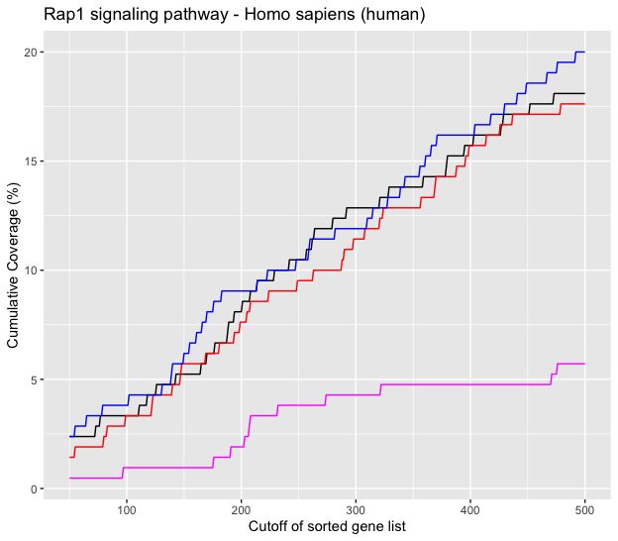
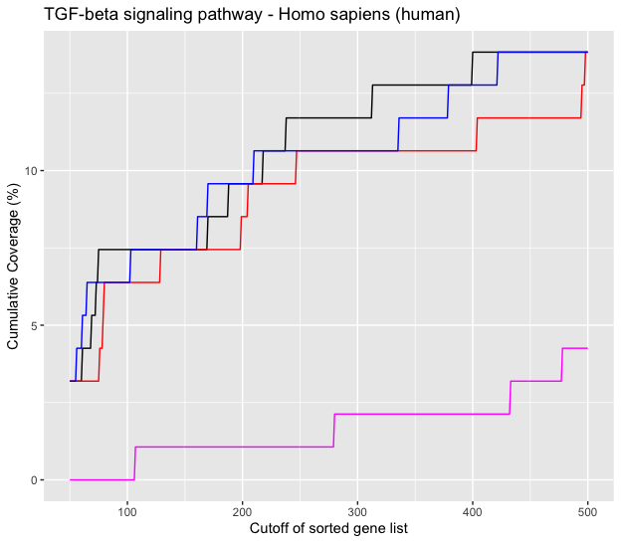
Enrichment
ToC
31

Slide 32
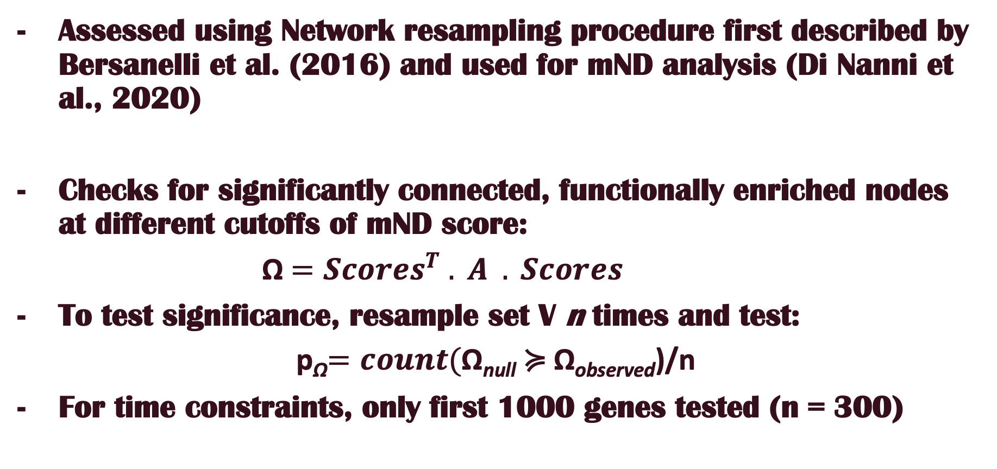
Connectivity
ToC
Assessed using Network resampling procedure first described by Bersanelli et al. (2016) and used for mND analysis (Di Nanni et al., 2020)
Checks for significantly connected, functionally enriched nodes at different cutoffs of mND score:
Ω $=Scores^{T} . A . Scores$
To test significance, resample set V n times and test:
p_{Ω}$=count($Ω_{null} ≽ Ω_{observed})/n
For time constraints, only first 1000 genes tested (n = 300)
32

Slide 33
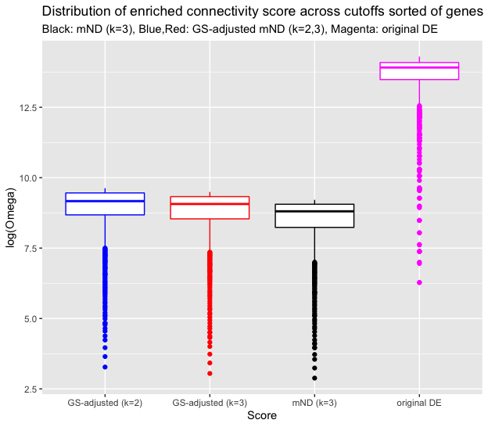
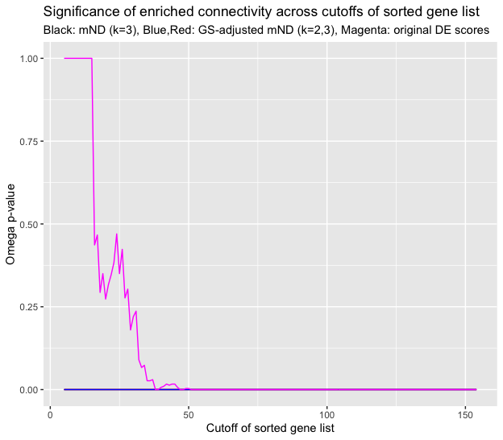
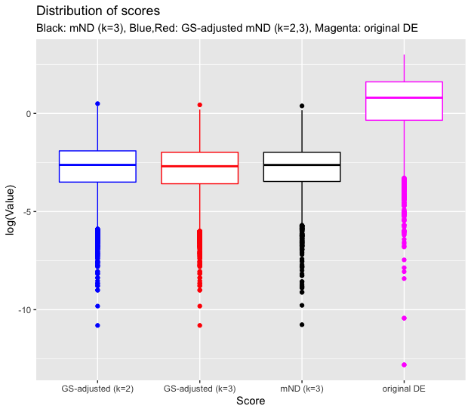
Connectivity
ToC
33

Slide 34
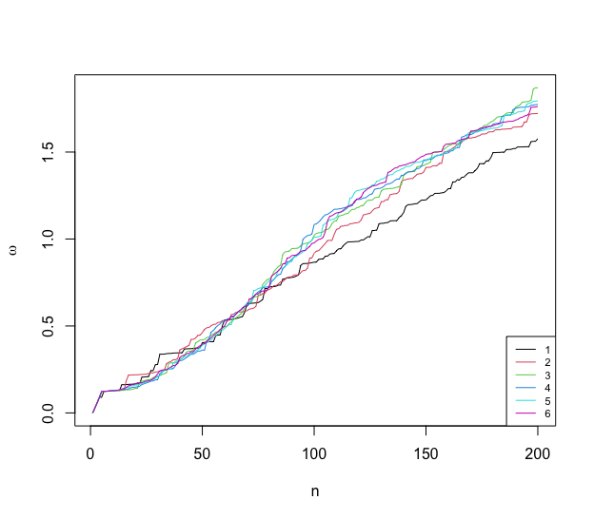
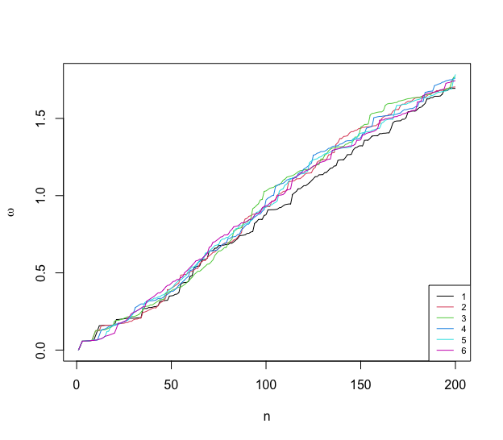
Optimizing k
ToC
mND alone
Adjusted mND
34

Slide 35
Conclusion
ToC
Future
Results seem encouraging so far, especially adjusted mND protocol with k = 2
There seems to be no need to extend neighbor search beyond R = 1 with GS adjustment
Repeat with p_{fisher} using data/sample
Optimize GS for runtime
Make use of Cumulative Decay Score to label newly found genes
Further investigate the effect of k and Ω
Comparing to other methods such as DMFIND
35

Slide 36
References
ToC
Babbi, G., Martelli, P. L., Profiti, G., Bovo, S., Savojardo, C., & Casadio, R. (2017). eDGAR: a database of Disease-Gene Associations with annotated Relationships among genes. BMC genomics, 18(5), 25- 34.
Bersanelli, M., Mosca, E., Remondini, D., Castellani, G., & Milanesi, L. (2016). Network diffusion-based analysis of high-throughput data for the detection of differentially enriched modules. Scientific reports, 6(1), 1-12.
Braun R, Shah S. Network methods for pathway analysis of gene expression data. 2014. arXiv [q-bio.QM]. arXiv. http://arxiv.org/abs/1411.1993.
Colaprico A, Silva TC, Olsen C, Garofano L, Cava C, Garolini D, Sabedot TS, Malta TM, Pagnotta SM, Castiglioni I, Ceccarelli M, Bontempi G, Noushmehr H. TCGAbiolinks: an R/Bioconductor package for integrative analysis of TCGA data. Nucleic Acids Res. 2016 May 5;44(8):e71. doi: 10.1093/nar/gkv1507. Epub 2015 Dec 23. PMID: 26704973; PMCID: PMC4856967.
Di Nanni, N., Bersanelli, M., Milanesi, L., & Mosca, E. (2020). Network diffusion promotes the integrative analysis of multiple omics. Frontiers in Genetics, 11, 106.
Di Nanni, N., Gnocchi, M., Moscatelli, M., Milanesi, L., & Mosca, E. (2020). Gene relevance based on multiple evidences in complex networks. Bioinformatics, 36(3), 865-871.
Gwinner, F., Boulday, G., Vandiedonck, C., Arnould, M., Cardoso, C., Nikolayeva, I., ... & Schwikowski, B. (2017). Network-based analysis of omics data: The LEAN method. Bioinformatics, 33(5), 701-709.
36

Slide 37
References
ToC
Manoli T, Gretz N, Gröne HJ, Kenzelmann M, Eils R, Brors B. Group testing for pathway analysis improves comparability of different microarray datasets. 2006; 22(20):2500.
Nikolayeva, I., Guitart Pla, O., Schwikowski, B. (2018). Network module identification—a widespread theoretical bias and best practices. Methods 132, 19–25. doi: 10.1016/j.ymeth.2017.08.008
Rappaport, N., Twik, M., Plaschkes, I., Nudel, R., Iny Stein, T., Levitt, J., ... & Lancet, D. (2017). MalaCards: an amalgamated human disease compendium with diverse clinical and genetic annotation and structured search. Nucleic acids research, 45(D1), D877-D887.
Ritchie ME, Phipson B, Wu D, Hu Y, Law CW, Shi W, Smyth GK. limma powers differential expression analyses for RNA-sequencing and microarray studies. Nucleic Acids Res. 2015; 43(7):e47.
Shah, S. D., & Braun, R. (2019). GeneSurrounder: network-based identification of disease genes in expression data. BMC bioinformatics, 20(1), 1-12.
Tomczak, K., Czerwińska, P., & Wiznerowicz, M. (2015). The Cancer Genome Atlas (TCGA): an immeasurable source of knowledge. Contemporary oncology (Poznan, Poland), 19(1A), A68–A77. https://doi.org/10.5114/wo.2014.47136
Ulgen, E., Ozisik, O., & Sezerman, O. U. (2019). pathfindR: an R package for comprehensive identification of enriched pathways in omics data through active subnetworks. Frontiers in genetics, 858.
37

Slide 38
Thank You
Thank You

